Slide 1
Digital Image Processing
Image Enhancement
Histogram Processing
Instructor Name
Dr. Muhammad Sharif

Slide 2
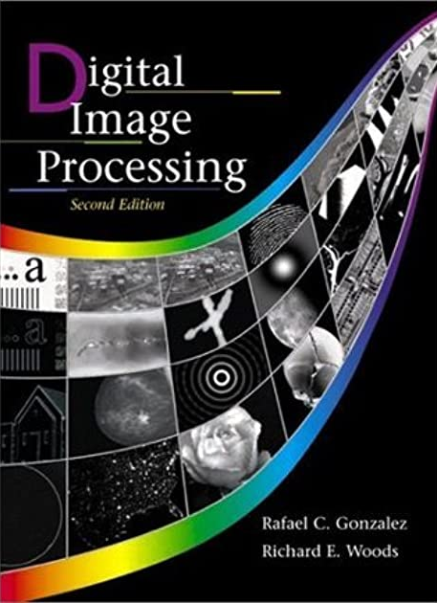
Material Reference
Images and Material
From
Rafael C. Gonzalez and Richard E. Wood,
Digital Image Processing, 2nd Edition.& Internet Resources
2

Slide 3
Contents
Over the next few lectures we will look at image enhancement techniques working in the spatial domain:
What is image enhancement?
Different kinds of image enhancement
Histogram processing
Point processing
Neighbourhood operations

Slide 4
A Note About Grey Levels
So far when we have spoken about image grey level values we have said they are in the range [0, 255]
- Where 0 is black and 255 is white
There is no reason why we have to use this range
- The range [0,255] stems from display technologies
For many of the image processing operations in this lecture grey levels are assumed to be given in the range [0.0, 1.0]

Slide 5
What Is Image Enhancement?
Image enhancement is the process of making images more useful
The reasons for doing this include:
Highlighting interesting detail in images
Removing noise from images
Making images more visually appealing

Slide 6
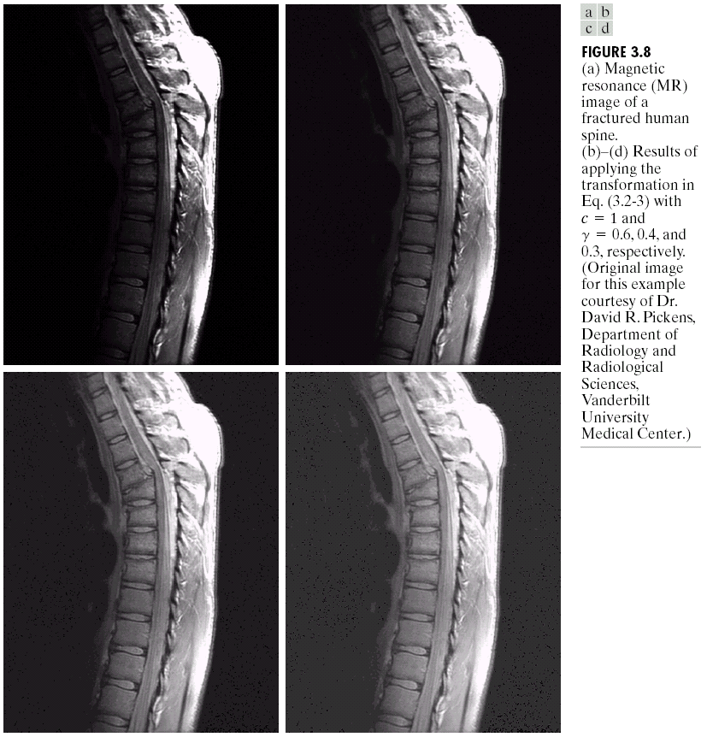
Image Enhancement Examples

Slide 7
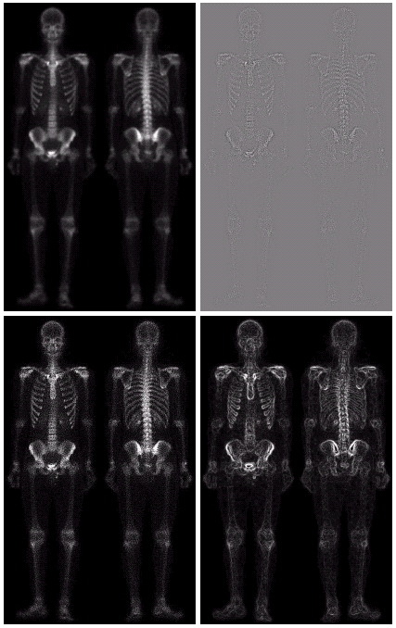
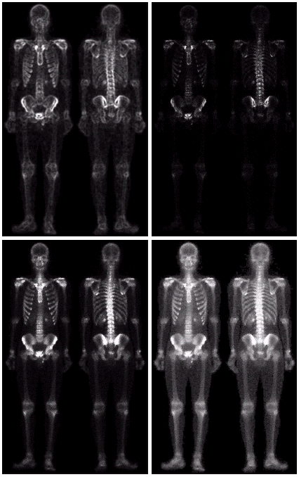
Image Enhancement Examples (cont.…)

Slide 8
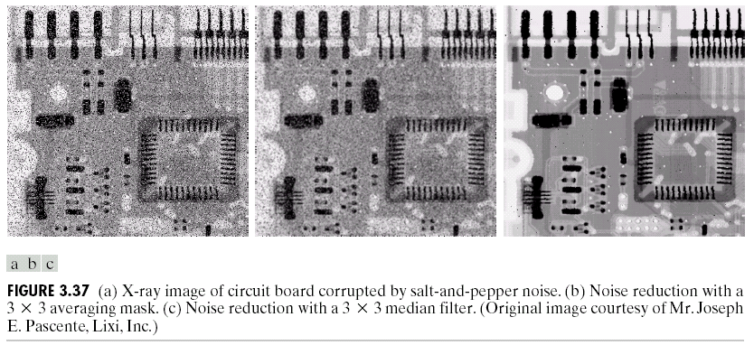
Image Enhancement Examples (cont.…)

Slide 9
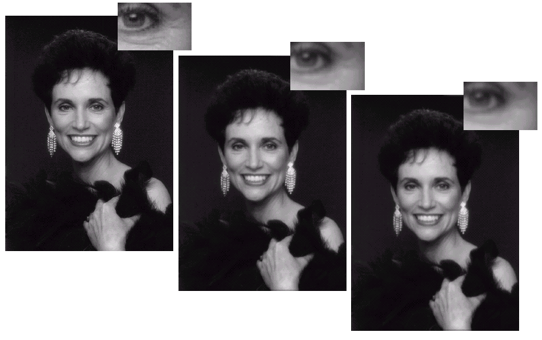
Image Enhancement Examples (cont.…)

Slide 10
Spatial & Frequency Domains
There are two broad categories of image enhancement techniques
Spatial domain techniques
Direct manipulation of image pixels
Frequency domain techniques
Manipulation of Fourier transform or wavelet transform of an image
For the moment we will concentrate on techniques that operate in the spatial domain

Slide 11
Image Histograms
The histogram of an image shows us the distribution of grey levels in the image
Massively useful in image processing, especially in segmentation
Frequencies
Grey Levels

Slide 12
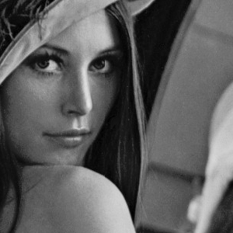
Histogram Examples

Slide 13
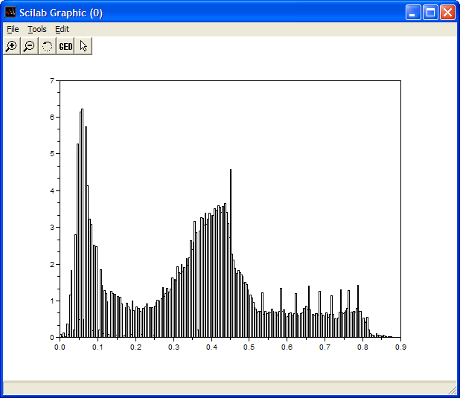
Histogram Examples (cont.…)

Slide 14

Histogram Examples (cont.…)

Slide 15
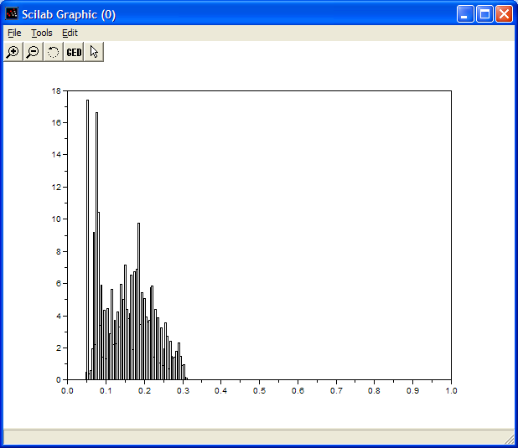
Histogram Examples (cont.…)

Slide 16
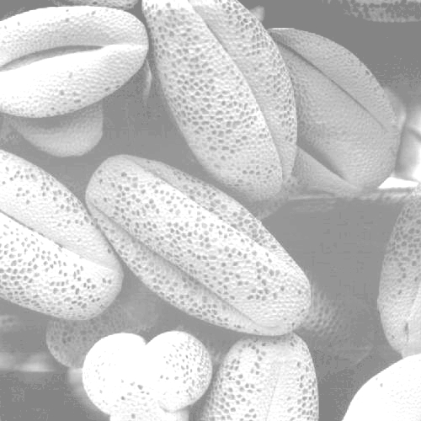
Histogram Examples (cont.…)

Slide 17
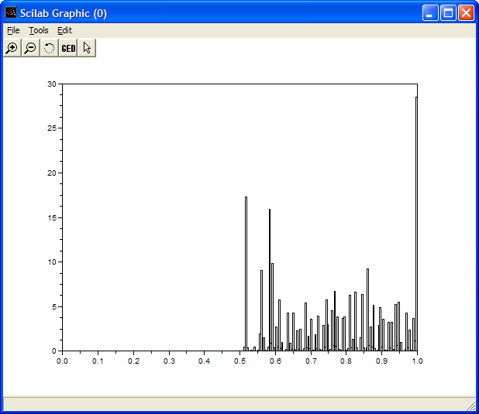
Histogram Examples (cont.…)

Slide 18

Histogram Examples (cont.…)

Slide 19
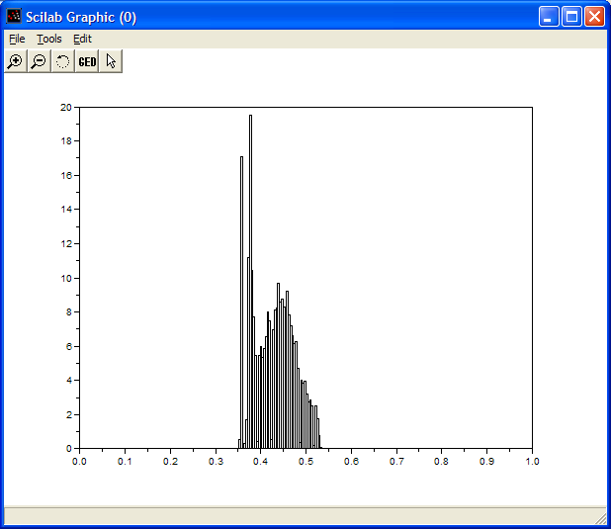
Histogram Examples (cont…)

Slide 20
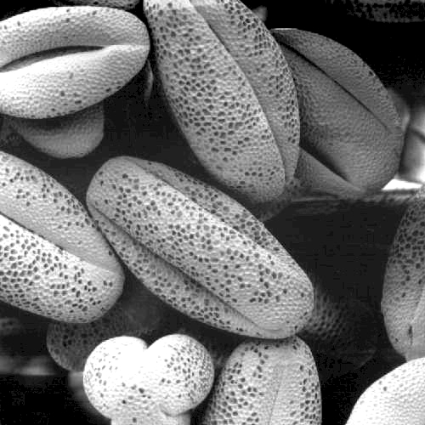
Histogram Examples (cont.…)

Slide 21
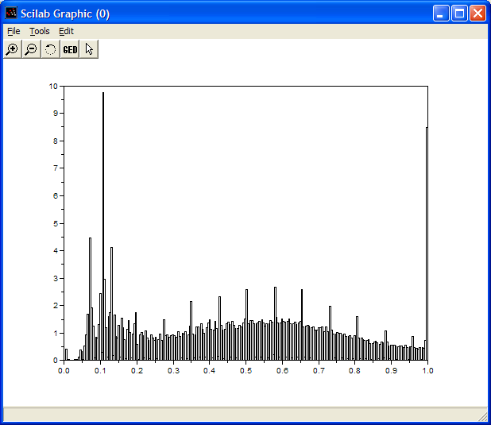
Histogram Examples (cont.…)

Slide 22
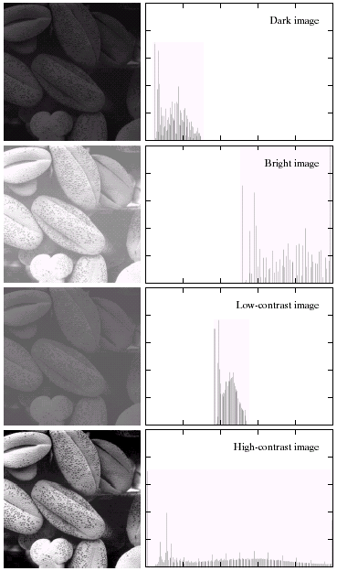
Histogram Examples (cont.…)
A selection of images and their histograms
Notice the relationships between the images and their histograms
Note that the high contrast image has the most evenly spaced histogram

Slide 23
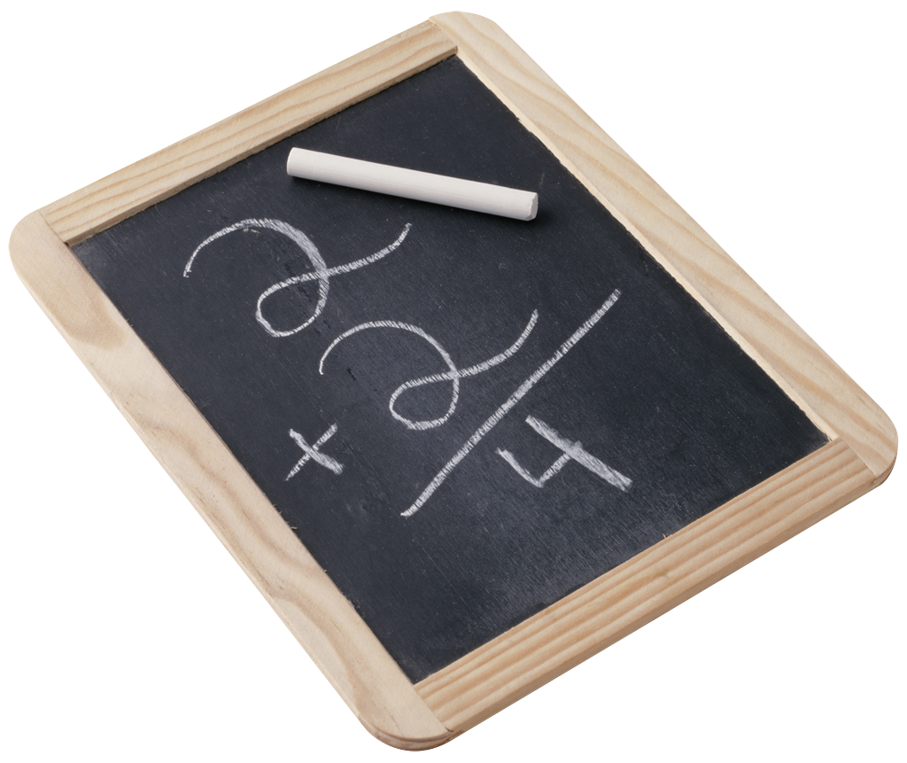
Contrast Stretching
We can fix images that have poor contrast by applying a pretty simple contrast specification
The interesting part is how do we decide on this transformation function?

Slide 24
Histogram Equalisation
Spreading out the frequencies in an image (or equalising the image) is a simple way to improve dark or washed out images
The formula for histogram equalisation is given where
r_{k}: input intensity
s_{k}: processed intensity
k: the intensity range (e.g 0.0 – 1.0)
n_{j}: the frequency of intensity j
n: the sum of all frequencies

Slide 25
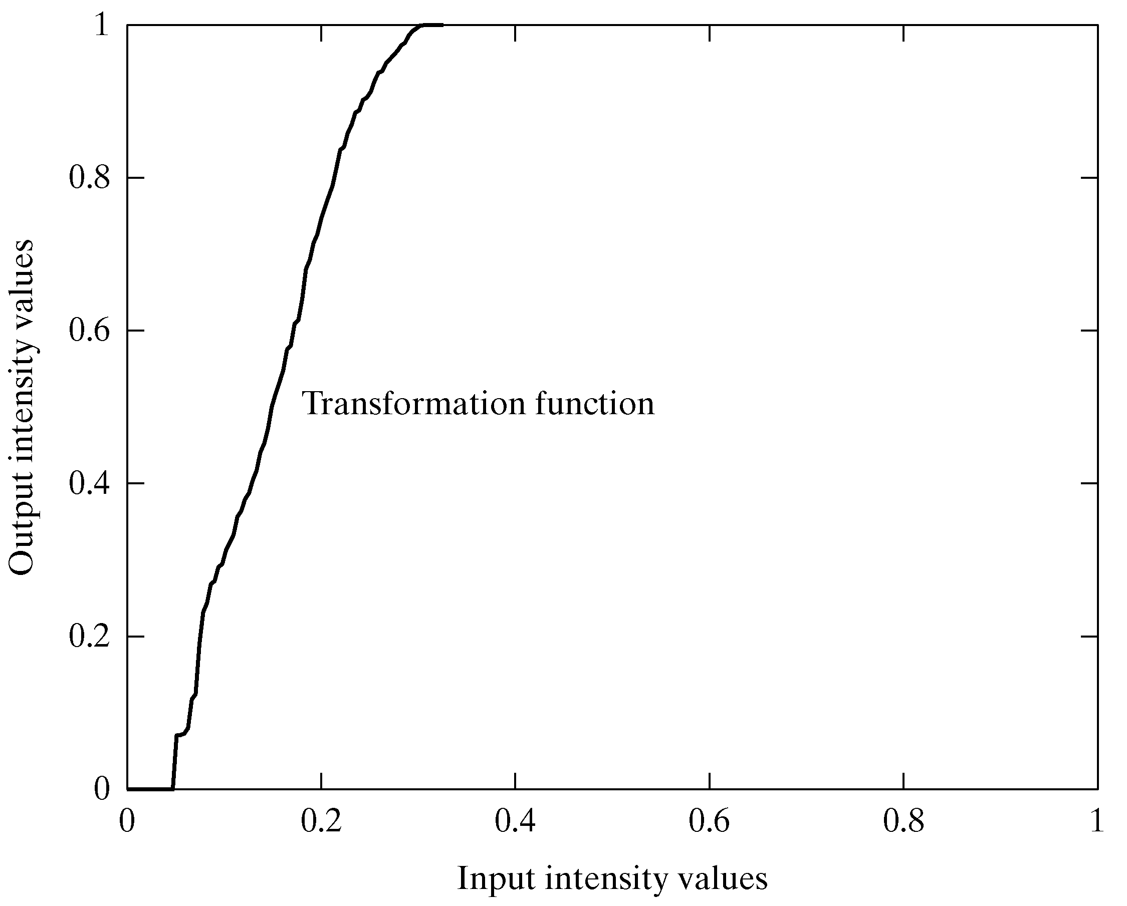
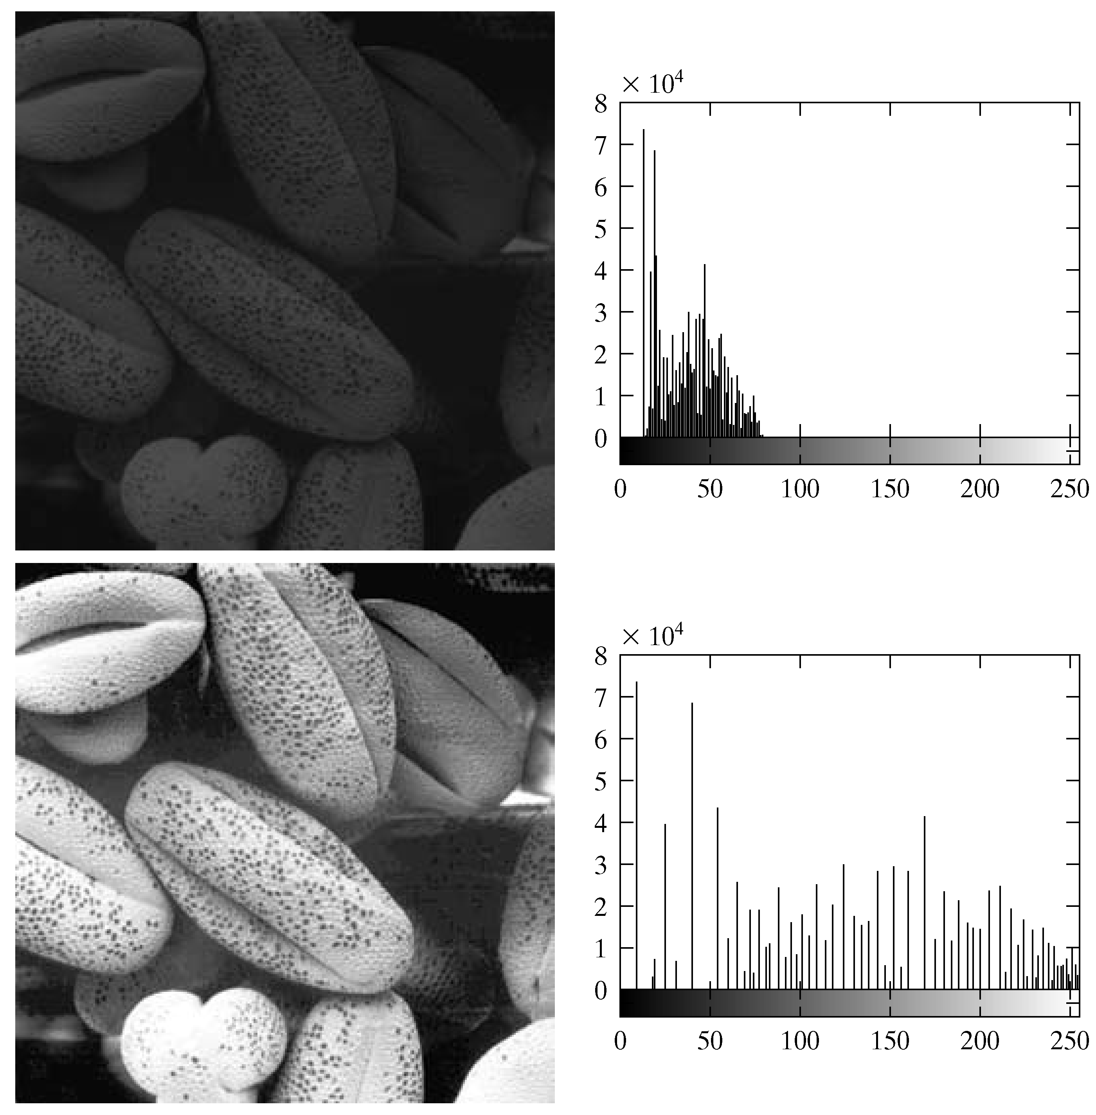
Equalisation Transformation Function

Slide 26
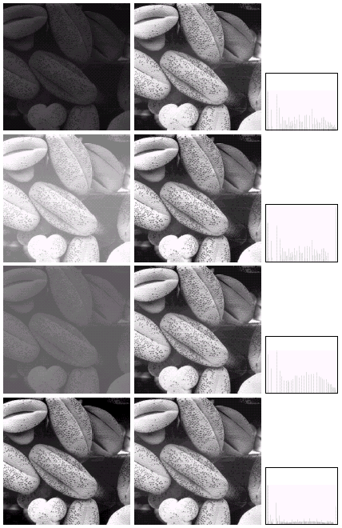
Equalisation Examples

Slide 27
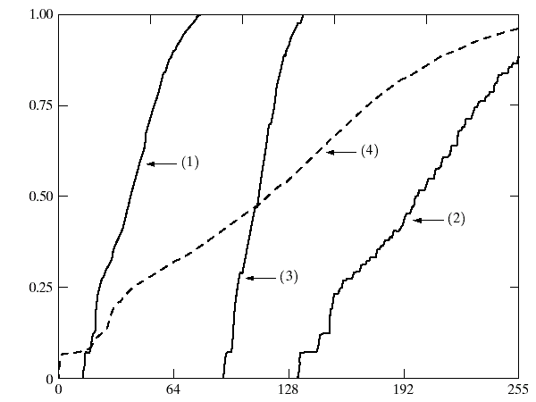
Equalisation Transformation Functions
The functions used to equalise the images in the previous example

Slide 28
Equalisation Examples

Slide 29
Equalisation Transformation Functions
The functions used to equalise the images in the previous example

Slide 30
Equalisation Examples (cont.…)

Slide 31
Equalisation Examples (cont.…)

Slide 32
Equalisation Transformation Functions
The functions used to equalise the images in the previous examples

Slide 33
Summary
We have looked at:
Different kinds of image enhancement
Histograms
Histogram equalisation
Next time we will start to look at point processing and some neighbourhood operations

Slide 34
THANK YOU

